Slide 1
Market Research and Identification of the potential Customers.

Slide 2
Key areas to identify opportunity
Need/ Want/and Demand
Need (defined)
Upper - Upper class
Upper Middle
Lower upper
Middle upper
Middle -Middle
Middle Middle
Lower Upper
Lower middle
Lower- Lower

Slide 3
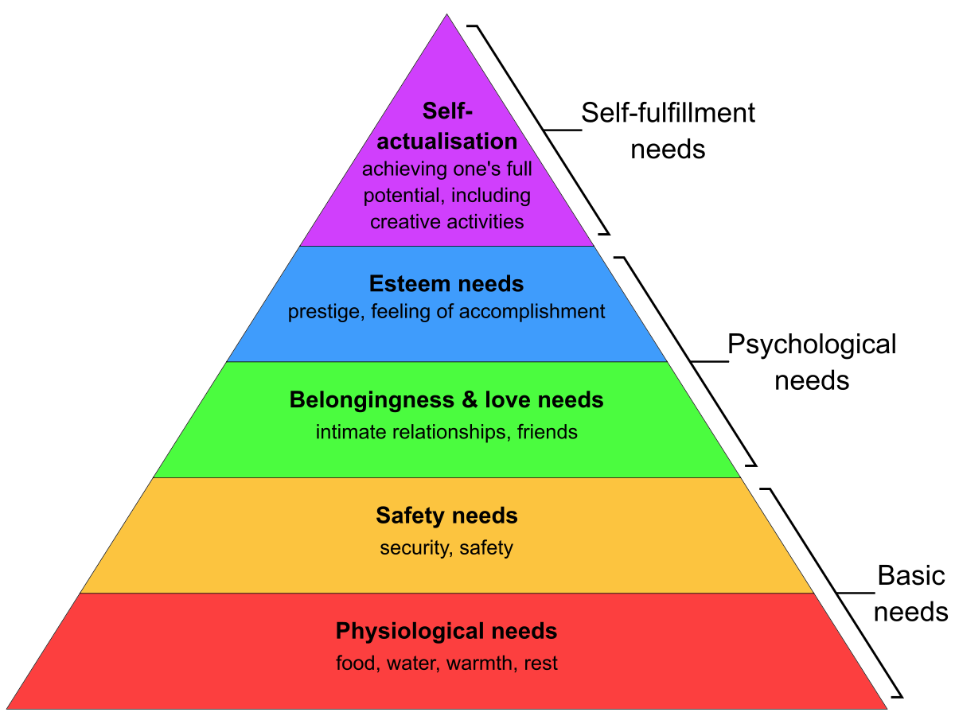
Maslow Hierarchy of Need

Slide 4
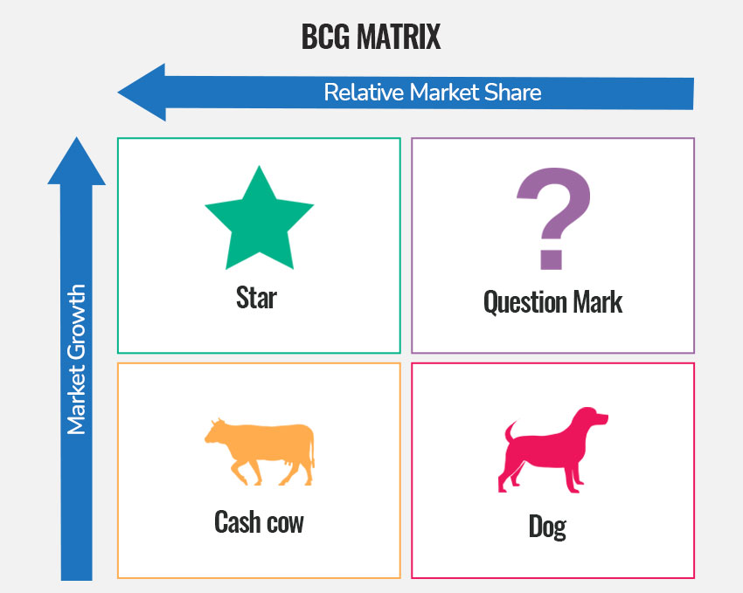
BCG Matrix (Growth Share Matrix)

Slide 5
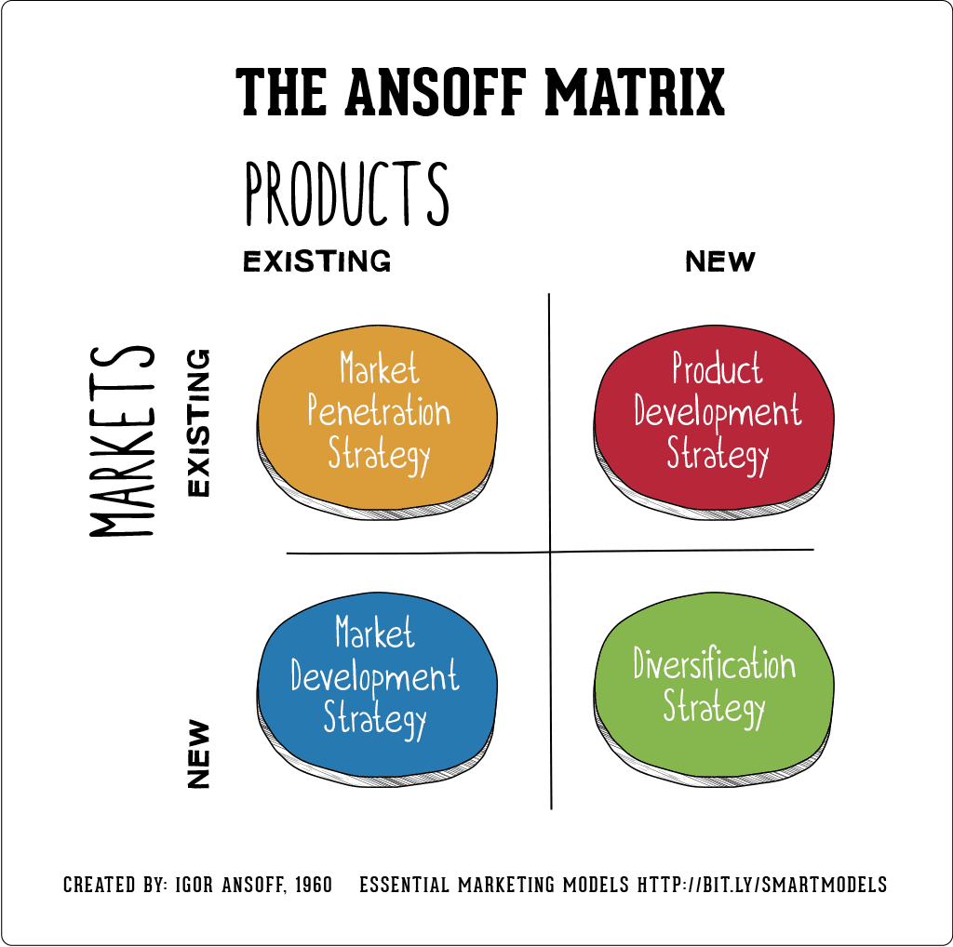
Product Market Extension Grid - Ans-Off

Slide 6
Product Portfolio
A product portfolio is a collection of all a company’s products and services to its customers. It encompasses a diverse range of items at varying stages in their lifecycle to meet a target market's diverse needs.

Slide 7
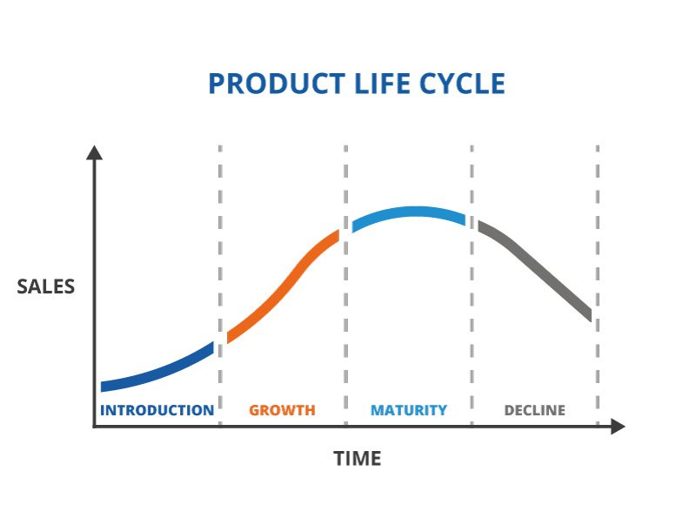
Product life cycle

Slide 8
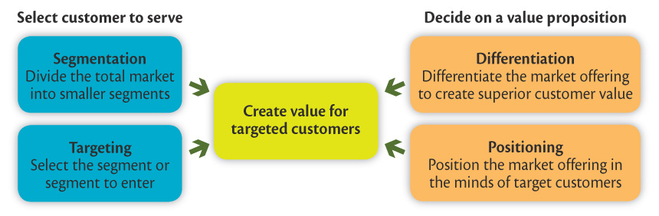
Market Segmentation
Marketing Targeting
Differentiation
Positioning for Competitive Advantage

Slide 9
Market Segmentation
Segmenting
Consumer markets
Business markets
International markets
Requirements for effective segmentation

Slide 10
Market Segmentation
Segmenting Consumer Markets
Marketers try different segmentation variables, alone and in combination, to find the best way to view the market structure.
Geographic segmentation
Demographic segmentation
Psychographic segmentation
Behavioral segmentation

Slide 11
Market Segmentation
Geographic segmentation divides the market into different geographical units such as nations, regions, states, counties, cities, or even neighborhoods.
Localizing products, advertising, promotion, and sales efforts to fit the needs of individual regions, cities, …

Slide 12
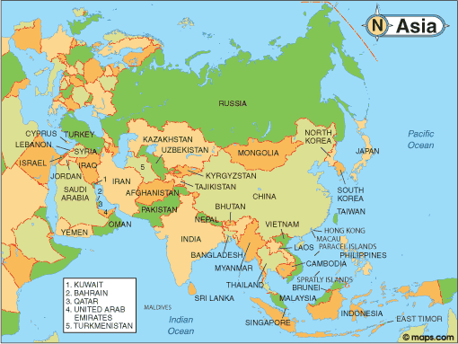
Geographic Segmentation - by nations
Notes:
can mention how the division of nations make up different markets
can further illustrate each nation is further divided into provinces/states/cities where the markets could be different

Slide 13
Market Segmentation
Demographic segmentation divides the market into groups based on variables such as age, gender, family size, family life cycle, income, occupation, education, religion, race, generation, and nationality.
(1) Consumer needs, wants, and usage rates often vary closely with demographic variables;
(2) Easier to measure than other variables;

Slide 14
Demographic segmentation - occupation
Notes:
illustrates different occupations could mean different buying power (eg. Doctors earn more than nurses)
different occupations could mean different needs for different types of products (eg. Office workers need to buy work clothes, while blue-collared workers usually attired differently)

Slide 15
Market Segmentation
Age and life-cycle stage segmentation is the process of offering different products or using different marketing approaches for different age and life-cycle groups.
Gender segmentation divides the market based on sex (male or female).
Income segmentation divides the market into affluent or low-income consumers.

Slide 16
Be careful to guard against stereotypes when using age and life-cycle segmentation.
Age is a poor predictor of a person’s life cycle, health, work or family status, needs and buying power.
What are the traditional family life-cycle stages?
Young singles
Married couples with children
What are the non-traditional family life-cycle stages? (Marketers are increasingly catering to…)
Unmarried couples
Singles marrying later in life
Childless couples
Same-sex couples
Single parents
Extended parents (those with young children returning home)

Slide 17

Age & Life Cycle Segmentation – families with young children
Notes:
Families with young children have different needs from families with grown children – products and services purchased differ

Slide 18



Market Segmentation
Psychographic segmentation divides buyers into different groups based on social class, lifestyle, or personality traits.

Slide 19
Market Segmentation
Behavioral segmentation divides buyers into groups based on their knowledge, attitudes, uses, or responses to a product.
Occasion
Benefits sought
User status
Usage rate
Loyalty status

Slide 20
Occasion segmentation divides buyers into groups according to occasions when they get the idea to buy, actually make purchases, or respond to a product. – help build up product usage
Benefit segmentation requires finding the major benefits people look for in the product class, the kinds of people who look for each benefit, and the major brands that deliver each benefit.

Slide 21

Occasion Segmentation – consumers buy special items for occasions like birthdays

Slide 22
Market Segmentation
User status divides buyers into ex-users, potential users, first-time users, and regular users of a product.
Usage rate divides buyers into light, medium, and heavy product users.
Loyalty status divides buyers into groups according to their degree of loyalty.

Slide 23
Market Segmentation
Using Multiple Segmentation Bases
Multiple segmentation is used to identify smaller, better-defined target groups.
Geodemographic segmentation is an example of multivariable segmentation that divides groups into consumer lifestyle patterns.

Slide 24
Explain which basis would be most important to marketers of Credit Cards
Demographic segmentation – income (gold and platinum cards)
Behavioral segmentation – usage rate (the higher usage rate customers are more profitable and appealing), user status (users of competing cards or banks)
Notes:
24

Slide 25
Explain which basis would be most important to marketers of Coffee
Demographic segmentation – income for premium brands
Geographical segmentation – taste and product form (instant vs. brewed)
Behavioral segmentation – occasions (out of home, eight o’clock), benefits sought (low acid)
Notes:
25

Slide 26
Market Segmentation
Requirements for Effective Segmentation
To be useful, a market segment must be:
Measurable
Accessible
Substantial
Differentiable
Actionable

Slide 27
Market Segmentation
Requirements for Effective Segmentation
Measurable: Examples include the size, purchasing power, and profiles of the segments
Accessible: Refers to the fact that the market can be effectively reached and served
Substantial: Refers to the fact that the markets are large and profitable enough to serve

Slide 28
Market Segmentation
Requirements for Effective Segmentation
Differentiable: Refers to the fact that the markets are conceptually distinguishable and respond differently to marketing mix elements and programs
Actionable: Refers to the fact that effective programs can be designed for attracting and serving the segments

Slide 29
Market Targeting
Concentrated marketing targets a small share of a large market; the marketer goes after a large share of one or a few niches.
Niche marketing appealing when
Limited resources
Greater knowledge of consumer needs in the niches
Special reputation
More effective and efficient
Higher-than-normal risks

Slide 30
Market Targeting
Micromarketing is the practice of tailoring products and marketing programs to suit the tastes of specific individuals and locations.
Local marketing
Individual marketing

Slide 31
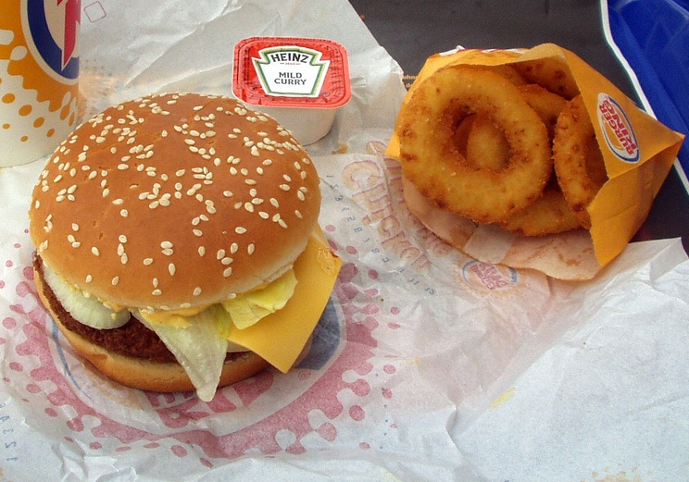
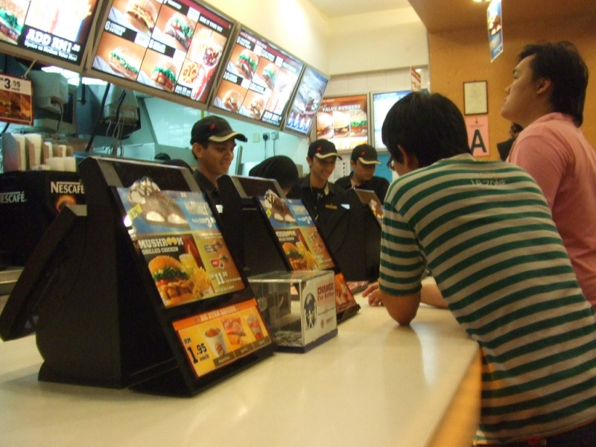
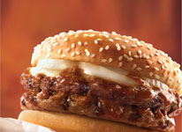

© Stephan Mosel
© Gene Lee
BK Double Rendang
Micromarketing – fast food chains like Burger King introduce rendang burgers in Singapore and Malaysia, where local palates prefer spicy food.

Slide 32
Market Targeting
Local marketing involves tailoring brands and promotion to the needs and wants of local customer groups (cities, neighborhoods and stores).
Benefits of local marketing
Increased marketing effectiveness in competitive markets
More customer-specific offerings
Challenges of local marketing
Increased manufacturing and marketing costs
Less economy of scale
Logistics
Dilution of company image

Slide 33
Market Targeting
Individual marketing involves tailoring products and marketing programs to the needs and preferences of individual customers.
Also known as:
One-to-one marketing
Mass customization
Markets-of-one marketing

Slide 34
Market Targeting
Mass customization is the process through which firms interact one-to-one with masses of customers to design products and services tailor-made to meet individual needs.
Has made relationships with customers important in the new economy
Provides a way to distinguish the company against competitors

Slide 35


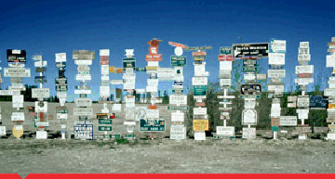
Mass customization by banks to reach groups of customers who hold large sums of savings and investments with the bank

Slide 36
Market Targeting
Choosing a Targeting Strategy
Depends on:
Company resources
Product variability
Product life-cycle stage
Market variability
Competitor’s marketing strategies

Slide 37
Market Targeting
Which targeting strategy is best:
When the firm’s resources are limited
Uniform products such as grapefruit or steel
Products that vary in design such as cameras and automobiles
When a firm introduces a new product
Most buyers have the same tastes, buy the same amounts, react the same way to marketing efforts
When competitors use differentiated marketing
Notes:
37

Slide 38
Market Targeting
Socially Responsible Target Marketing
Concerned with the issues of targeting vulnerable or disadvantaged consumers with controversial or potentially harmful products
Vulnerable segments: children, minorities
Controversial products: alcohol, cigarettes, fast-food
Benefits both company and targeted customers with specific needs
Case: Tainted Sanlu Infant Milk Powder Incident http://www.youtube.com/watch?v=xtTey7-3Zuk&NR=1
http://www.youtube.com/watch?v=MsIn6iTgL3Q

Slide 39
Differentiation and Positioning
Product position is the way the product is defined by consumers on important attributes—the place the product occupies in consumers’ minds relative to competing products.
Perceptions
Impressions
Feelings

Slide 40
Differentiation and Positioning
Positioning maps show consumer perceptions of their brands versus competing products on important buying dimensions.
Price and orientation

Slide 41
Differentiation and Positioning
Choosing a Differentiation and Positioning Strategy
Identifying a set of possible competitive advantages to build a position
Choosing the right competitive advantages
Selecting an overall positioning strategy
Competitive advantage is the advantage over competitors gained by offering greater value either through lower prices or by providing more benefits that justify higher prices

Slide 42
Differentiation and Positioning
Choosing a Differentiation and Positioning Strategy
Step 1: Identifying a set of possible competitive advantages to build a position by providing superior value from:
Product differentiation on features, performance, style or design
Service differentiation through speedy, convenient, or careful delivery
Channels - coverage, expertise, and performance
People – hiring and training better people
Image – company or brand image

Slide 43




© Nakedsky.org
© Rick Hall
© James Cridland
Singapore Airlines may charge a higher price, but provides excellent services – product and service differentiation.
© juandazeng | Flickr.com

Slide 44
Differentiation and Positioning
Step 2: Choosing the Right Competitive Advantages
A difference is worth establishing to the extent that it satisfies the following criteria:
Important – delivers a highly valued benefit to target buyers
Distinctive – offers in a more distinctive way
Superior – superior to other ways
Communicable – visible to buyers
Preemptive – cannot easily be copied
Affordable – buyers can pay for the difference
Profitable

Slide 45
Differentiation and Positioning
Step 3: Selecting an Overall Strategy
Value proposition is the full mix of benefits upon which a brand is positioned.
More for more
More for the same
Same for less
Less for much less
More for less

Slide 46
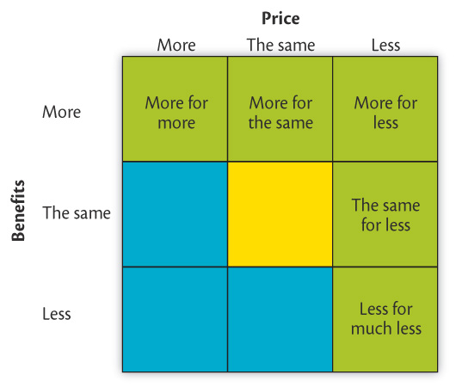
Figure 7.7
Possible value propositions

Slide 47
Positioning for a Competitive Advantage
Developing a Positioning Statement
Positioning statement states the product’s membership in a category and then shows its point-of-difference from other members of the category.
“To (target segment and need), our (brand) is (concept) that (point of difference).”
To busy professionals who need to stay organized, Palm is an electronic organizer that allows you to backup files on your PC more easily and reliably than competitive products

Slide 48
Video Case: Procter & Gamble
Discussion Questions:
How does P&G use positioning to differentiate the brands in a particular product category?
What basis of segmentation does P&G use to differentiate the products?
How does P&G use its variety of brands to build relationships with the right customers?
Notes:
48

Slide 49
Market Segmentation
Market segmentation is the process that companies use to divide large heterogeneous markets into small markets that can be reached more efficiently and effectively with products and services that match their unique needs.
Use a variety of different meaningful variables (bases) for segmenting
Segments can be better reached with the resources of the marketer

Slide 50
Market Segmentation
Segmenting
Consumer markets
Business markets
International markets
Requirements for effective segmentation

Slide 51
Market Segmentation
Segmenting Consumer Markets
Marketers try different segmentation variables, alone and in combination, to find the best way to view the market structure.
Geographic segmentation
Demographic segmentation
Psychographic segmentation
Behavioral segmentation

Slide 52
Market Segmentation
Segmenting Consumer Markets
Geographic segmentation divides the market into different geographical units such as nations, regions, states, counties, cities, or even neighborhoods.
Localizing products, advertising, promotion, and sales efforts to fit the needs of individual regions, cities, …

Slide 53
Geographic Segmentation - by nations
Notes:
can mention how the division of nations make up different markets
can further illustrate each nation is further divided into provinces/states/cities where the markets could be different

Slide 54
Market Segmentation
Segmenting Consumer Markets
Demographic segmentation divides the market into groups based on variables such as age, gender, family size, family life cycle, income, occupation, education, religion, race, generation, and nationality.
(1) Consumer needs, wants, and usage rates often vary closely with demographic variables;
(2) Easier to measure than other variables;

Slide 55
Demographic segmentation - occupation
Notes:
illustrates different occupations could mean different buying power (eg. Doctors earn more than nurses)
different occupations could mean different needs for different types of products (eg. Office workers need to buy work clothes, while blue-collared workers usually attired differently)

Slide 56
Market Segmentation
Segmenting Consumer Markets
Age and life-cycle stage segmentation is the process of offering different products or using different marketing approaches for different age and life-cycle groups.
Gender segmentation divides the market based on sex (male or female).
Income segmentation divides the market into affluent or low-income consumers.

Slide 57
Be careful to guard against stereotypes when using age and life-cycle segmentation.
Age is a poor predictor of a person’s life cycle, health, work or family status, needs and buying power.
What are the traditional family life-cycle stages?
Young singles
Married couples with children
What are the non-traditional family life-cycle stages? (Marketers are increasingly catering to…)
Unmarried couples
Singles marrying later in life
Childless couples
Same-sex couples
Single parents
Extended parents (those with young children returning home)

Slide 58
Age & Life Cycle Segmentation – families with young children
Notes:
Families with young children have different needs from families with grown children – products and services purchased differ

Slide 59
Market Segmentation
Segmenting Consumer Markets
Psychographic segmentation divides buyers into different groups based on social class, lifestyle, or personality traits.

Slide 60
Market Segmentation
Segmenting Consumer Markets
Behavioral segmentation divides buyers into groups based on their knowledge, attitudes, uses, or responses to a product.
Occasion
Benefits sought
User status
Usage rate
Loyalty status

Slide 61
Market Segmentation
Segmenting Consumer Markets
Occasion segmentation divides buyers into groups according to occasions when they get the idea to buy, actually make purchases, or respond to a product. – help build up product usage
Benefit segmentation requires finding the major benefits people look for in the product class, the kinds of people who look for each benefit, and the major brands that deliver each benefit.

Slide 62
Occasion Segmentation – consumers buy special items for occasions like birthdays

Slide 63
Market Segmentation
Segmenting Consumer Markets
User status divides buyers into ex-users, potential users, first-time users, and regular users of a product.
Usage rate divides buyers into light, medium, and heavy product users.
Loyalty status divides buyers into groups according to their degree of loyalty.

Slide 64
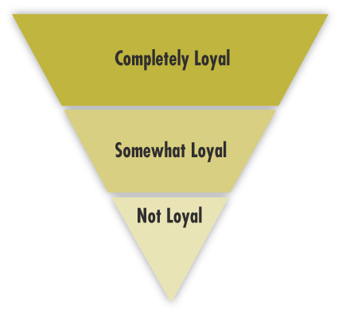
Market Segmentation
Segmenting Consumer Markets
Loyalty status divides buyers into groups according to their degree of loyalty.

Slide 65
Market Segmentation
Using Multiple Segmentation Bases
Multiple segmentation is used to identify smaller, better-defined target groups.
Geodemographic segmentation is an example of multivariable segmentation that divides groups into consumer lifestyle patterns.

Slide 66
Explain which basis would be most important to marketers of Vitamins
Demographic segmentation – age and gender
Psychographic segmentation – very active or “extreme” lifestyle individuals
Behavioral segmentation – benefits sought, with some having calcium, vitamin B12, and even nutraceutical or herbal components
Notes:
66

Slide 67
Explain which basis would be most important to marketers of Credit Cards
Demographic segmentation – income (gold and platinum cards)
Behavioral segmentation – usage rate (the higher usage rate customers are more profitable and appealing), user status (users of competing cards or banks)
Notes:
67

Slide 68
Explain which basis would be most important to marketers of Coffee
Demographic segmentation – income for premium brands
Geographical segmentation – taste and product form (instant vs. brewed)
Behavioral segmentation – occasions (out of home, eight o’clock), benefits sought (low acid)
Notes:
68

Slide 69
Market Segmentation
Segmenting Business Markets
Business buyers can be segmented using many of the same variables as consumers:
Geographically
Demographically (industry, company size)
Behaviorally (benefits sought, user status, usage rate, and loyalty status)

Slide 70
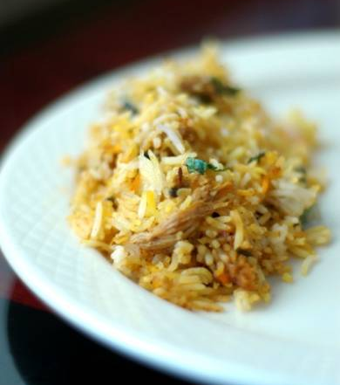
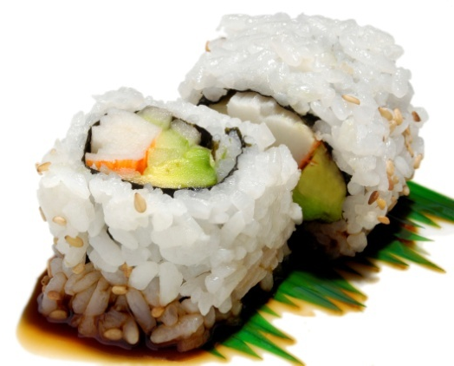
Market Segmentation
Segmenting International Markets
Intermarket segmentation divides consumers into groups with similar needs and buying behaviors even though they are located in different countries.
Intermarket segmentation – whether Japanese, Chinese, Thais, or Indians, they all consume rice

Slide 71
Market Segmentation
Requirements for Effective Segmentation
To be useful, a market segment must be:
Measurable
Accessible
Substantial
Differentiable
Actionable

Slide 72
Market Segmentation
Requirements for Effective Segmentation
Measurable: Examples include the size, purchasing power, and profiles of the segments
Accessible: Refers to the fact that the market can be effectively reached and served
Substantial: Refers to the fact that the markets are large and profitable enough to serve

